Slide 1
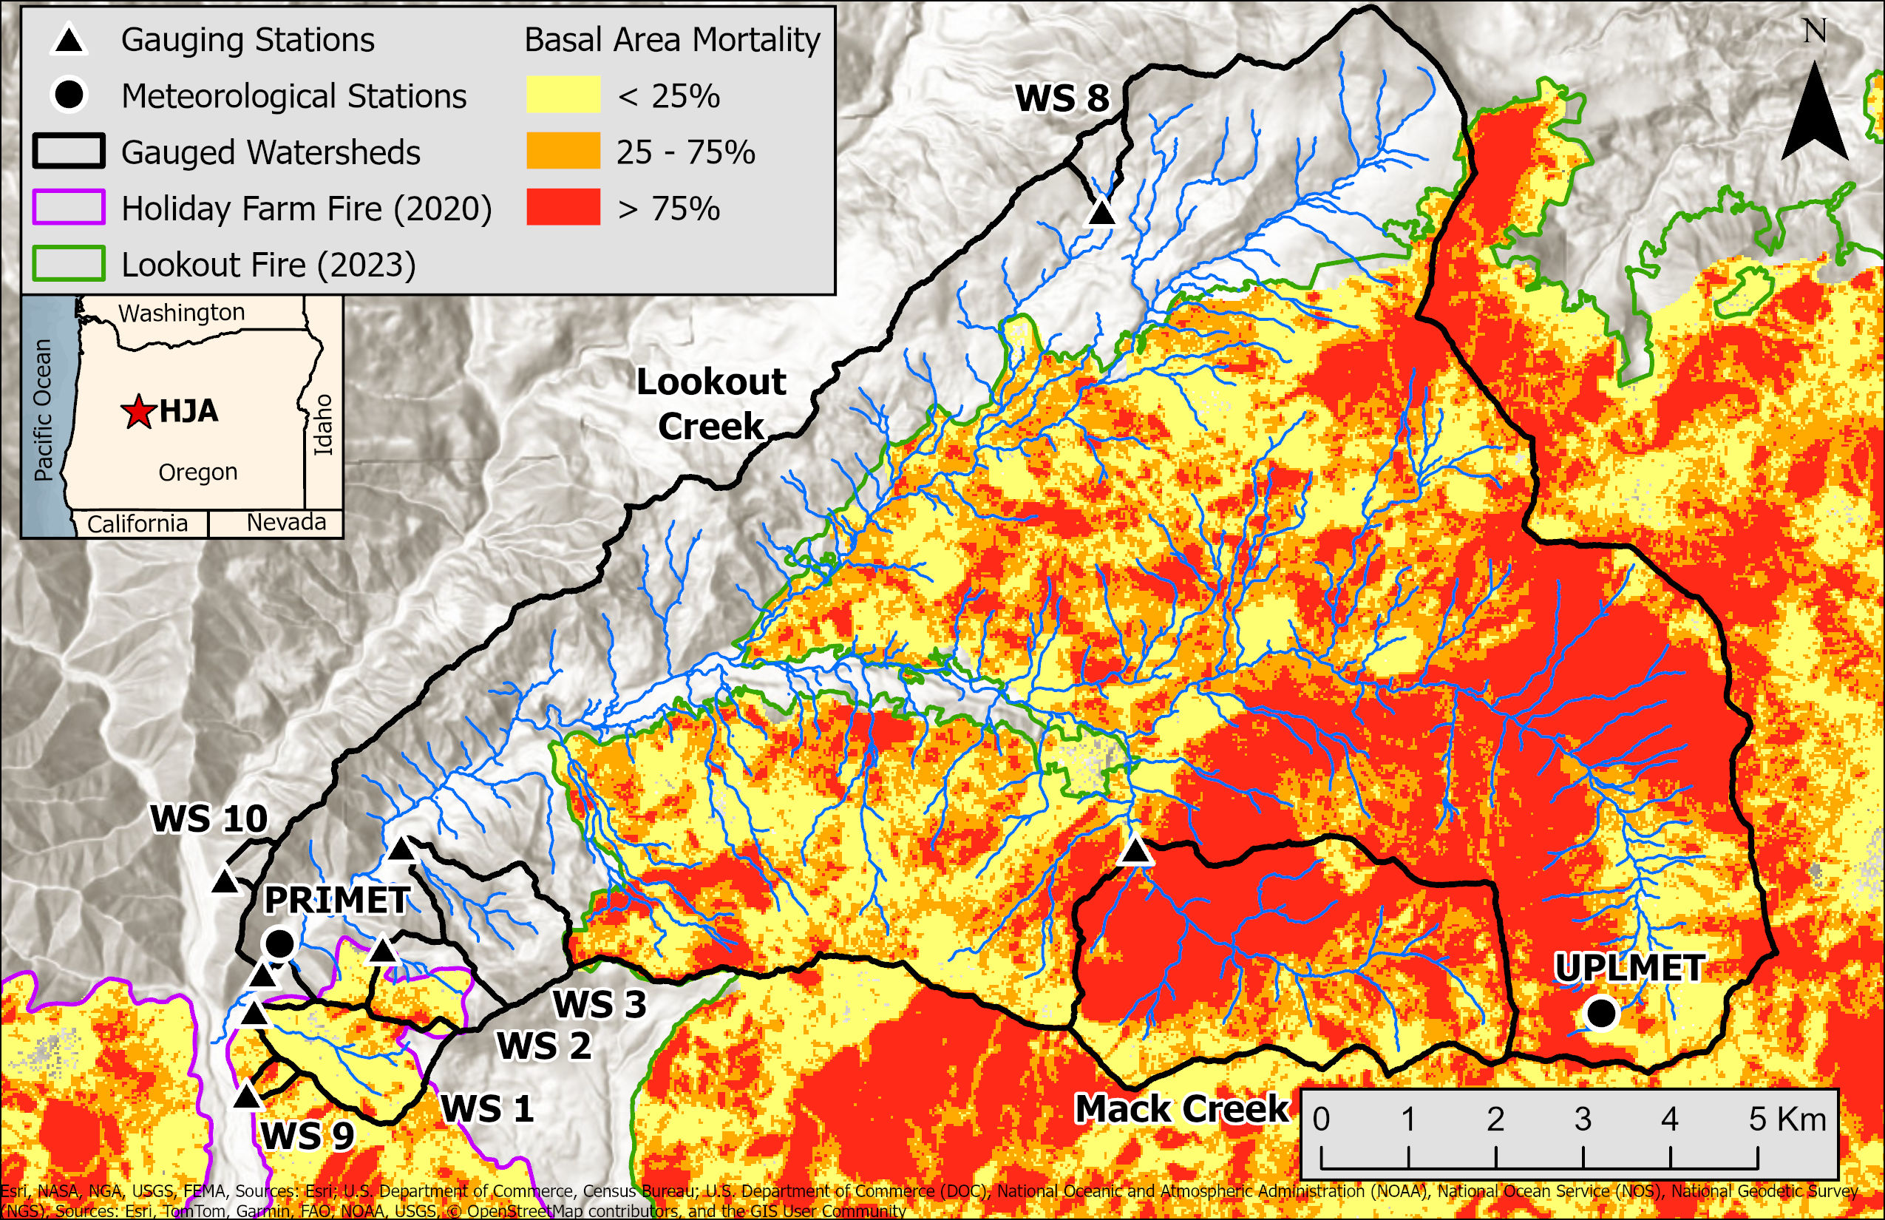
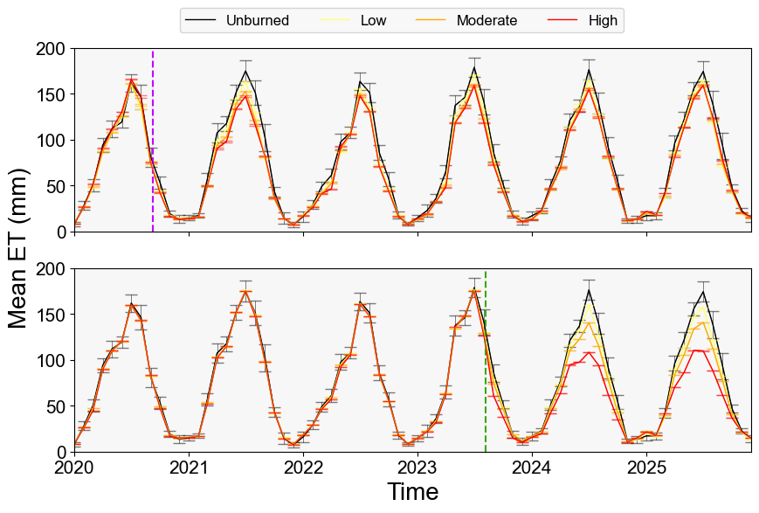
A
B
Holiday Farm Fire
Lookout Fire

Slide 2
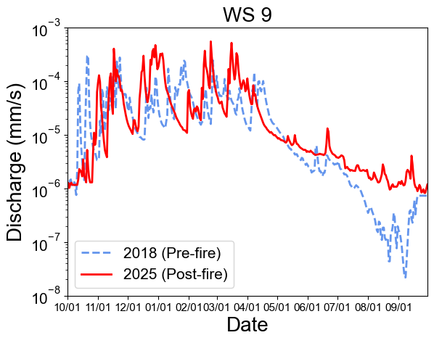
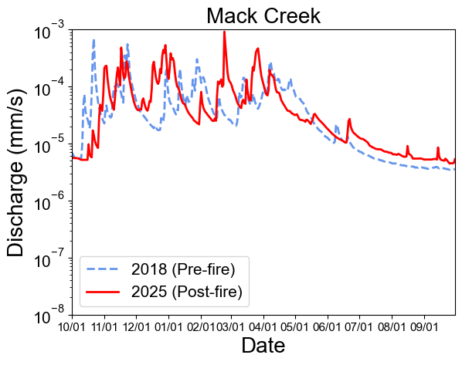
A
B

Slide 3
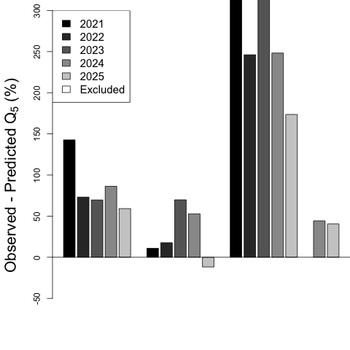
*
*
*
*
*
Basal Area Mortality
WS 1
WS 2
WS 9
MC
Low
Low
Moderate
High
Storage
Low
High
Low
Moderate

Slide 4
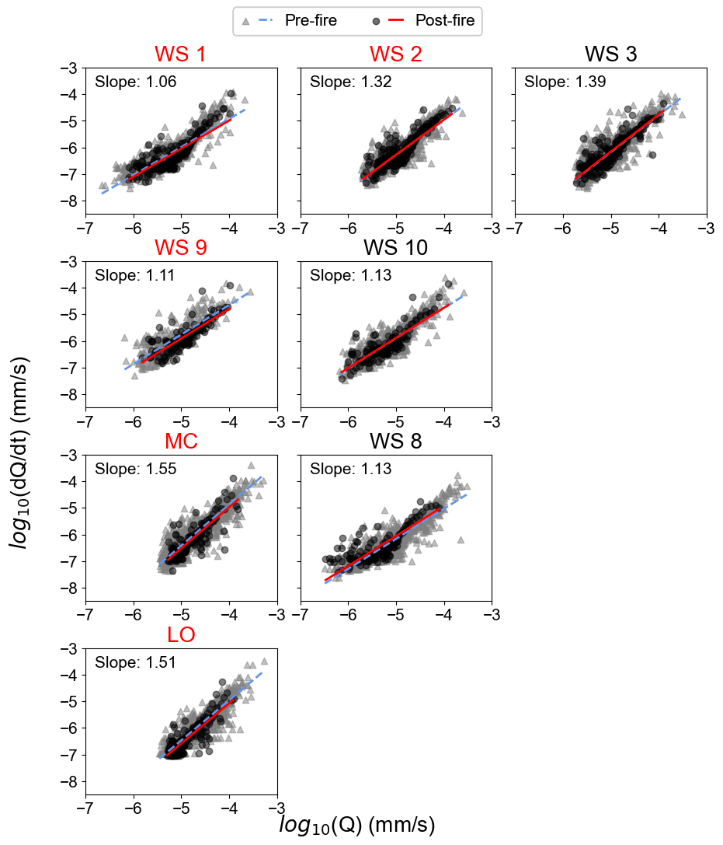
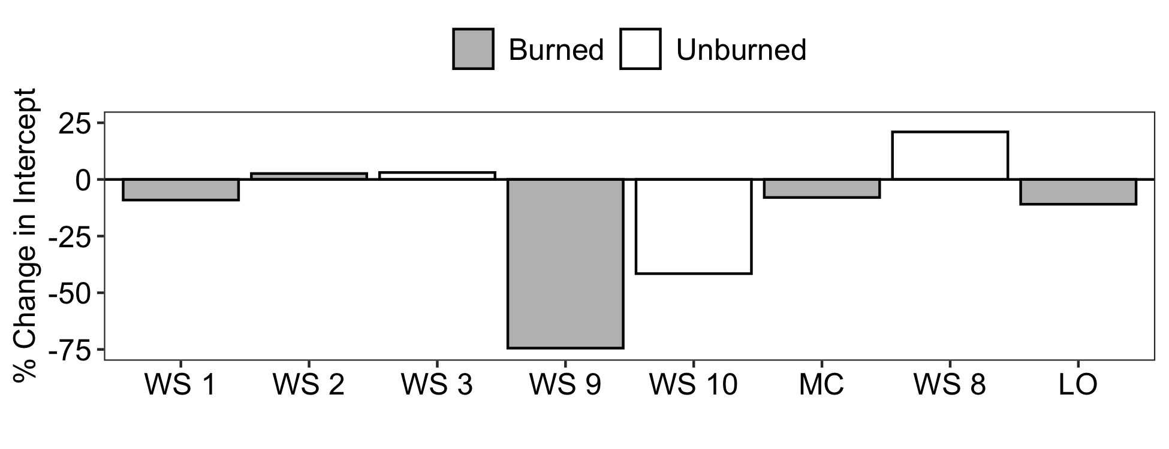
A
B
***
**
***
***
***

Slide 5
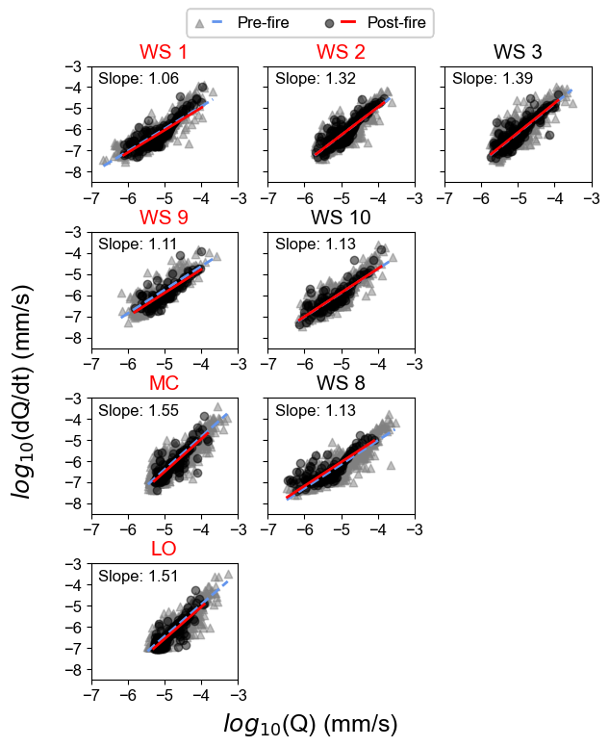
A
B
***
**
***
***
***

Slide 6
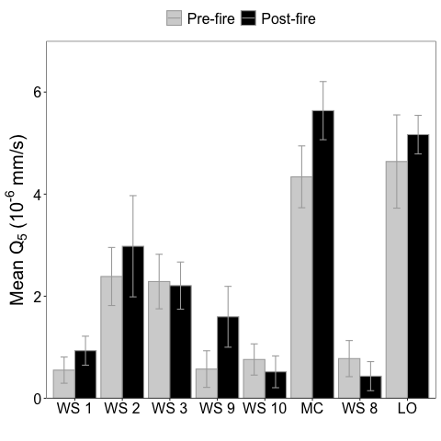
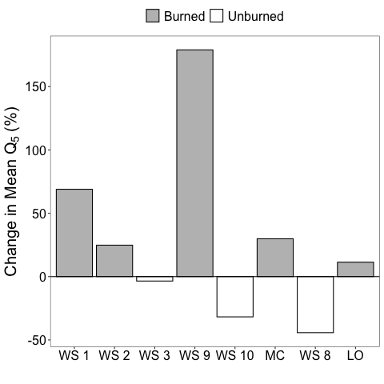
A
B

